Slide 1
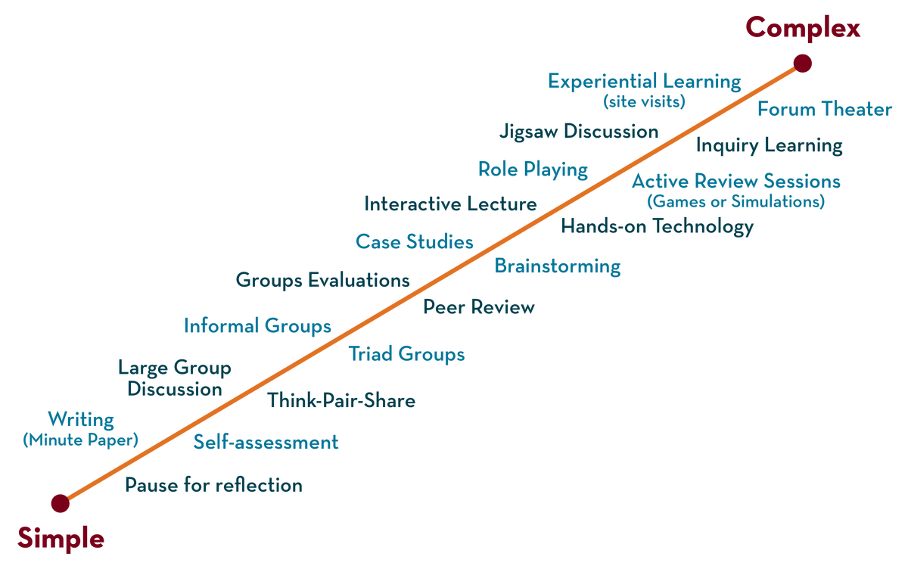
Department of AI&DS
COURSE NAME – ADAPTIVE Software Engineering
COURSE CODE – 22CS2119R
Topic:
Black-box and White-box testing
Session - 17

Slide 2



AIM OF THE SESSION
To familiarize students with the basic concept of Black-box and White-box testing
INSTRUCTIONAL OBJECTIVES
This Session is designed to:
Describe Black-box testing
Describe White-box testing
Describe the Advantages and Disadvantages of Black-box testing
Describe the Advantages and Disadvantages of White-box testing
Comparison between black-box and white-box testing
LEARNING OUTCOMES
At the end of this session, you should be able to:
Describe Black-box testing.white-box testing
Describe the Advantages and Disadvantages of Black-box testing, white-box testing
Describe the Advantages and Disadvantages of White-box testing
Comparison between black-box and white-box testing

Slide 3

SESSION DESCRIPTION
Black-Box Testing
The technique of testing without having any knowledge of the interior workings of the application is called black-box testing.
The tester is oblivious to the system architecture and does not have access to the source code.
While performing a black-box test, a tester will interact with the system's user interface by providing inputs and examining outputs without knowing how and where the inputs are worked upon.

Slide 4
The following table lists the advantages and disadvantages of black-box testing.
Advantages | Disadvantages
Well suited and efficient for large code segments. | Limited coverage, since only a selected number of test scenarios is actually performed.
Code access is not required. | Inefficient testing, due to the fact that the tester only has limited knowledge about an application.
Clearly separates user's perspective from the developer's perspective through visibly defined roles. | Blind coverage, since the tester cannot target specific code segments or errorprone areas.
Large numbers of moderately skilled testers can test the application with no knowledge of implementation, programming language, or operating systems. | The test cases are diffi

Slide 5
White-Box Testing
White-box testing is the detailed investigation of internal logic and structure of the code.
White-box testing is also called glass testing or open-box testing.
In order to perform white-box testing on an application, a tester needs to know the internal workings of the code.
The tester needs to have a look inside the source code and find out which unit/chunk of the code is behaving inappropriately.

Slide 6
The following table lists the advantages and disadvantages of white-box testing.
Advantages | Disadvantages
As the tester has knowledge of the source code, it becomes very easy to find out which type of data can help in testing the application effectively. | Due to the fact that a skilled tester is needed to perform white-box testing, the costs are increased.
It helps in optimizing the code. | Sometimes it is impossible to look into every nook and corner to find out hidden errors that may create problems, as many paths will go untested.

Slide 7
The following table lists the advantages and disadvantages of white-box testing.
Extra lines of code can be removed which can bring in hidden defects. | It is difficult to maintain white-box testing, as it requires specialized tools like code analyzers and debugging tools.
Due to the tester's knowledge about the code, maximum coverage is attained during test scenario writing.

Slide 8
A Comparison of Testing Methods
Black-Box Testing |  | White-Box Testing
The internal workings of an application need not be known. |  | Tester has full knowledge of the internal workings of the application.
Also known as closed-box testing, data-driven testing, or functional testing. |  | Also known as clear-box testing, structural testing, or code-based testing.
Performed by end-users and also by testers and developers. |  | Normally done by testers and developers.

Slide 9
A Comparison of Testing Methods
Testing is based on external expectations - Internal behavior of the application is unknown. |  | Internal workings are fully known and the tester can design test data accordingly.
It is exhaustive and the least time-consuming. |  | The most exhaustive and time-consuming type of testing.
Not suited for algorithm testing. |  | Suited for algorithm testing.
This can only be done by trial-and-error method. |  | Data domains and internal boundaries can be better tested.

Slide 10
SELF-ASSESSMENT QUESTIONS
Describe Black-box testing
Describe White-box testing
Describe the Advantages and Disadvantages of Black-box testing
Describe the Advantages and Disadvantages of White-box testing
Comparison between black-box and white-box testing

Slide 11
REFERENCES FOR FURTHER LEARNING OF THE SESSION
Reference Books:
2. TEXT BOOKS:
Roger S.Pressman, “Software Engineering – A Practitioner’s Approach” 7th Edition, Mc Graw Hill,(2014).
Ian Sommerville, “Software Engineering”, Tenth Edition, Pearson Education, (2015).
Reference Book
Agile and Iterative Development: A Manager's Guide, Craig Larman, Addison-Wesley
WEB REFERNCES/MOOCS:
https://www.digite.com/kanban/what-is-kanban/
http://www.scaledagileframework.com
https://www.guru99.com/test-driven-development.html
https://junit.org/junit5/

Slide 12
THANK YOU
Team – Adaptive Software Engineering

